Slide 1
Image Classification Flower Recognition
Alex Song

Slide 2
Intro – The Problem
GOAL: train, test, and evaluate a deep learning model that can automatically classify flower images into one of five categories:
Daisy
Dandelion
Rose
Sunflower
Tulip
Objective: evaluate the model’s performance.

Slide 3
DatA Used
Kaggle Flowers Recognition dataset was used in this data model.(https://www.kaggle.com/datasets/alxmamaev/flowers-recognition)
Approximately 4,200 images
Divided into five classes: daisy, dandelion, rose, sunflower, and tulip.
Images are stored in separate folders by class

Slide 4
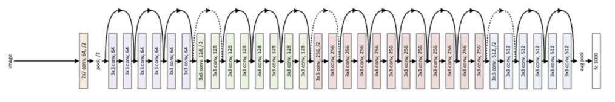
Data Processing & Modeling
Training process:
Loading the Kaggle Flower Recognition Dataset
Splitting it into training (70%) and validation (30%)
After repeated 14 times, the error rate went down from 10% to 5%.

Slide 5
Analysis methods
Confusion Matrix
Classification Report
Top Losses Review
External Image Testing
Notes:
generalization ability using images not seen during training.

Slide 6
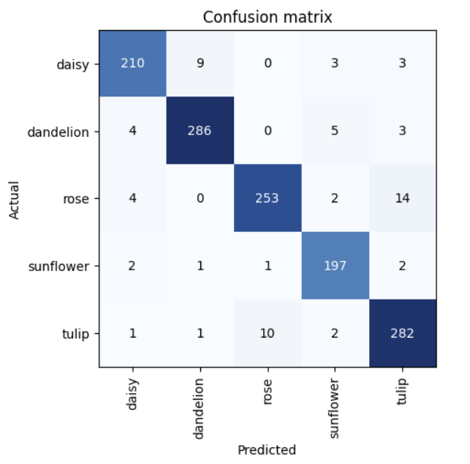
Result
Most flowers were recognized with high reliability
Minor misclassification
Rose & Tulip
Daisy & Dandelion

Slide 7
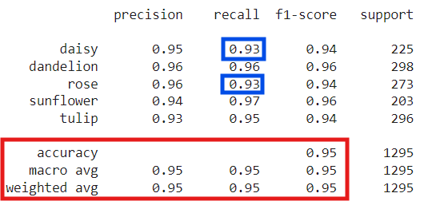
Result
Precision & Recall < 93% overall
Recall rate of .93 for daisy & rose

Slide 8
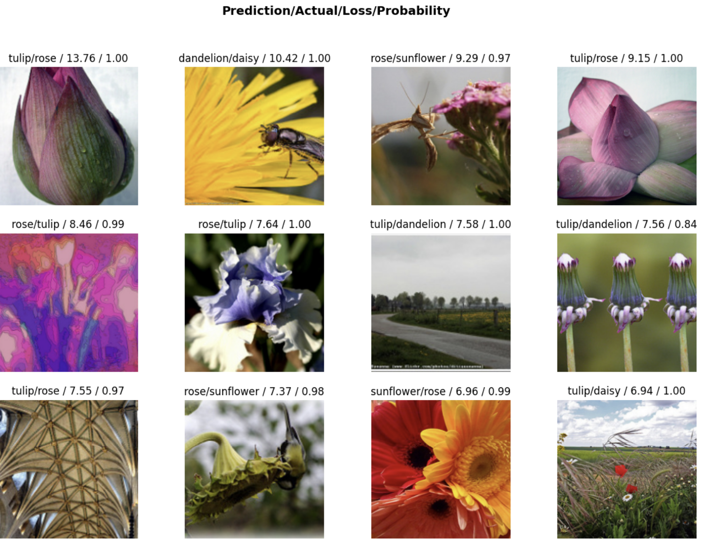
Result
Percision & Recall < 93% overall
Recall rate of .93 for daisy & rose

Slide 9
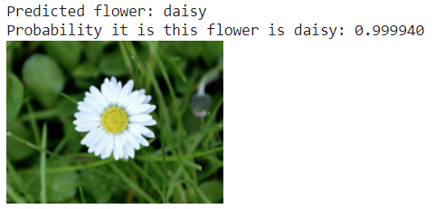
Result
Tested with an image of daisy
Probability: .999940

Slide 10
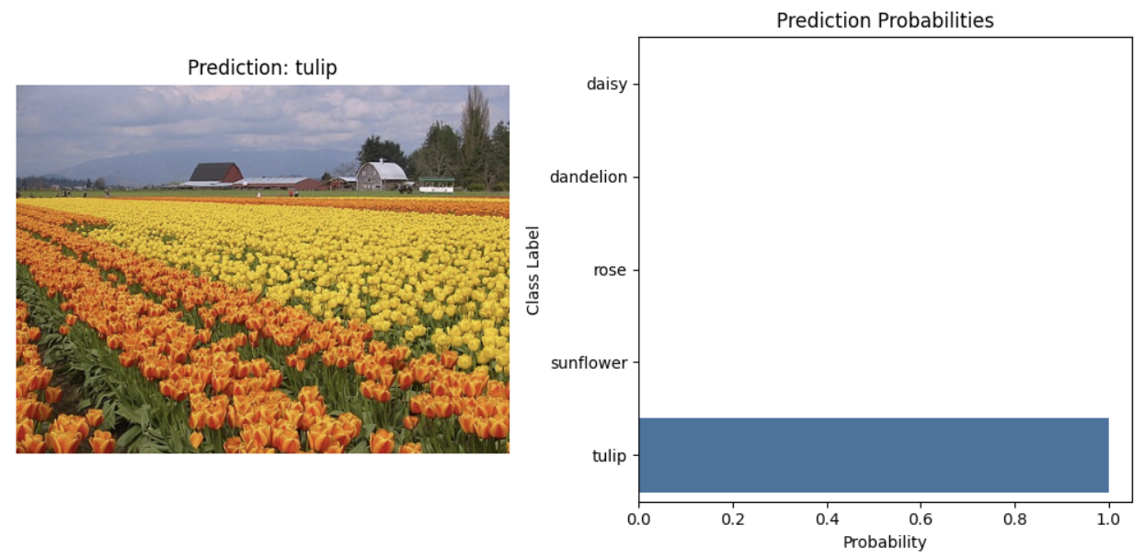
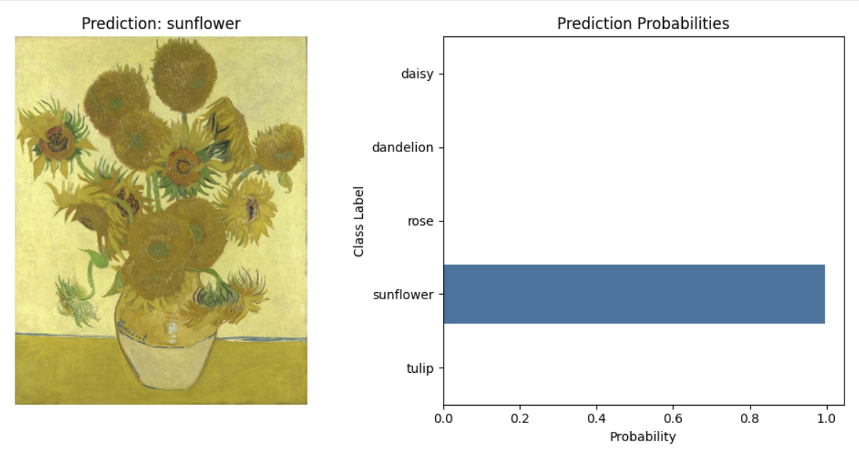
Result
Most flowers were recognized with high reliability
Minor misclassification
Rose & Tulip
Daisy & Dandelion

Slide 11
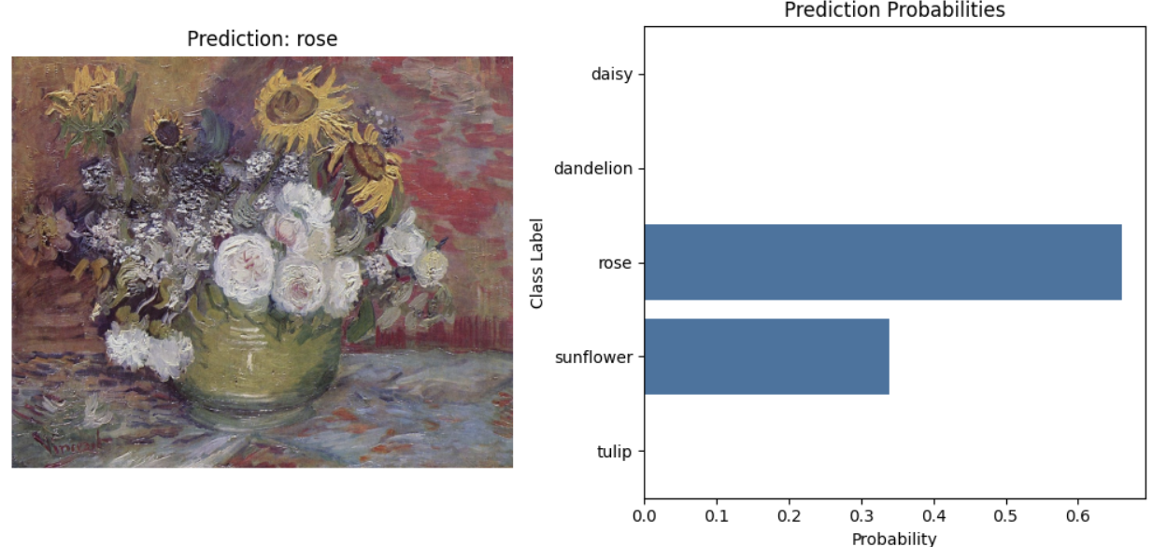
Roses & Sunflowers
Most flowers were recognized with high reliability
Minor misclassification
Rose & Tulip
Daisy & Dandelion

Slide 12

Result
The trained model demonstrated strong overall performance on the validation dataset, supported by both quantitative and qualitative analysis.
The model achieved high accuracy, indicating that it effectively learned to distinguish among the five flower categories.

